Slide 1

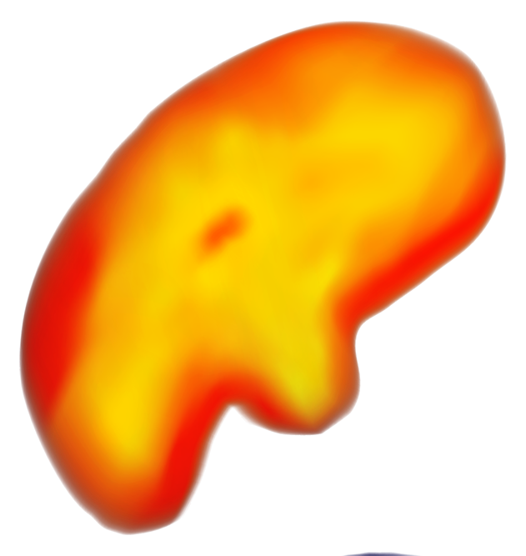
Cyclonic Cartography
Mapping Significant Tornadoes

Slide 2
Team
Amanda Pigman
Angie Foust
Barb Rupps
Cassidy Simmons
Scott Arterbury

Slide 3
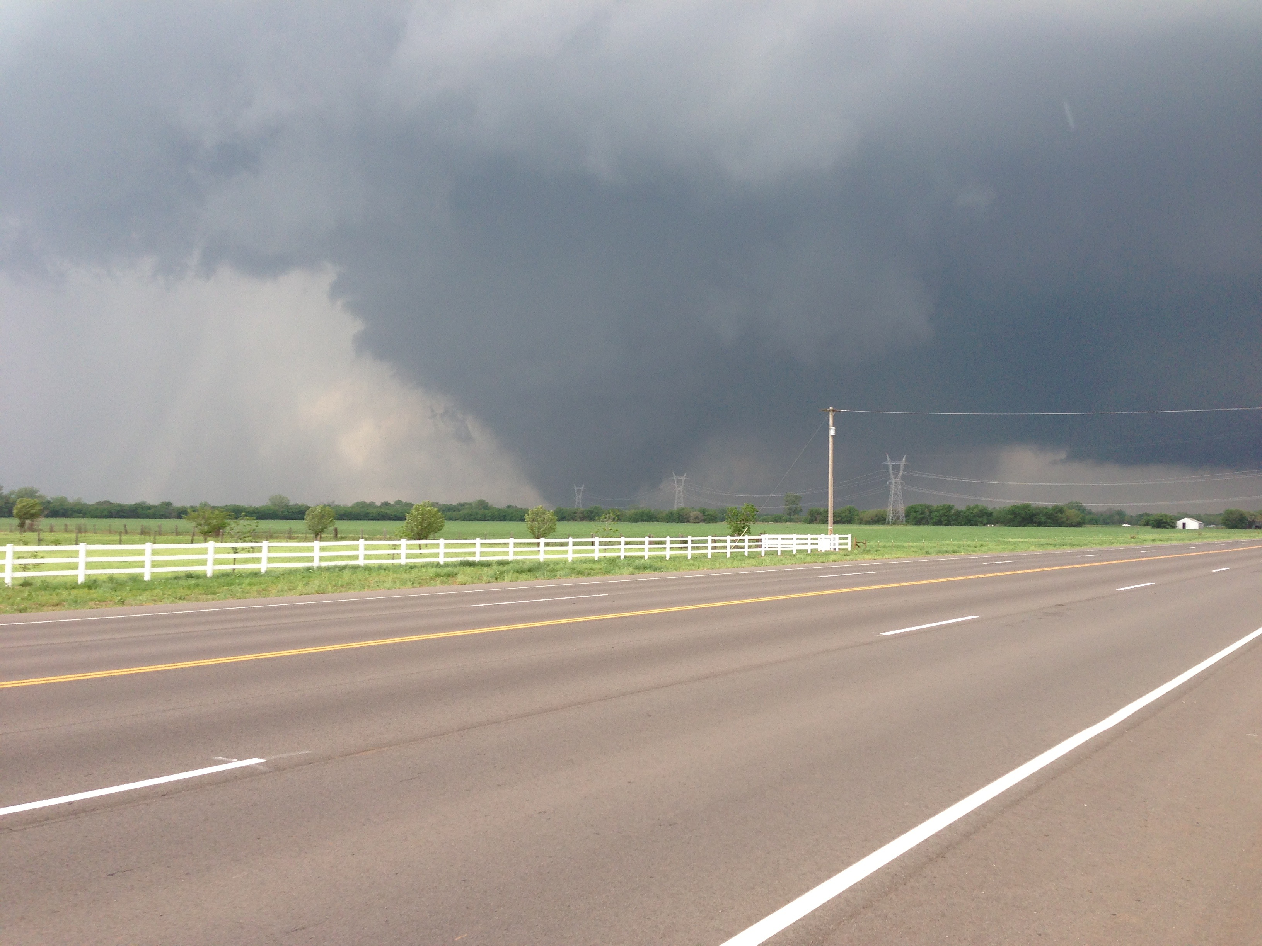
May 13, 2013 — Moore, Oklahoma

Slide 4
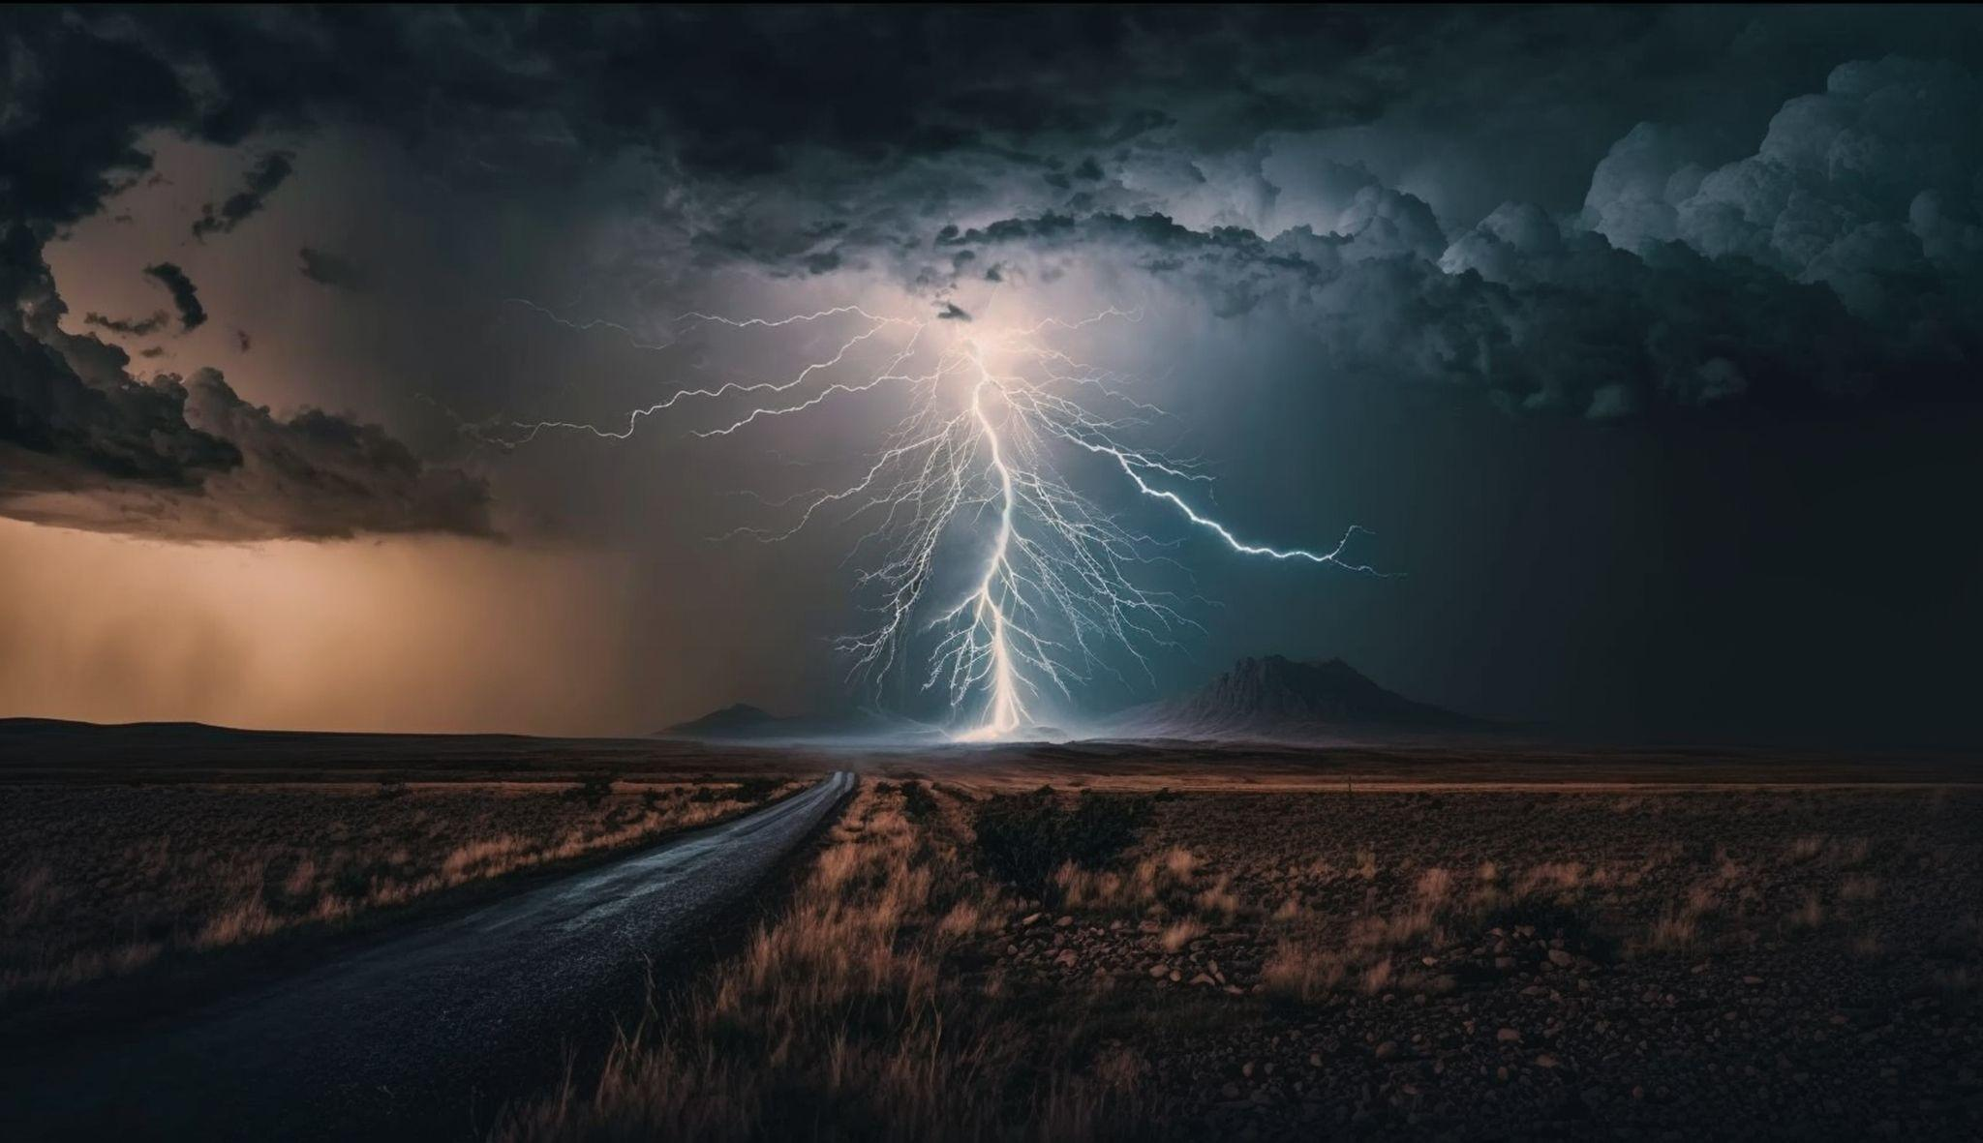
Is Tornado Alley Shifting?
Living in Oklahoma, we are keenly aware of severe weather.
However, it seems like there are not as many tornadoes as there used to be in this area.
We wanted to see what the data said.

Slide 5
Methodology
Source
Our Scope
The National Weather Service
(www.weather.gov) was our source.
Weather is a huge topic and we needed focus:
All tornadoes?
As far back as there are records?
Significant tornadoes?
Limit to more recent years?
Has tornado alley shifted?

Slide 6
Extract, Transform, and Load
Data Sourcing
Data Cleaning
Data Loading
Using the National Weather Service’s data, we filtered all weather events to tornadoes. We determined to focus on the data starting January 1, 2000 and EF 3 and stronger tornadoes.
We cleaned the data by removing columns of information that we didn’t need for our analysis and combining multiple CSV files (due to limitations from the website) into one file.
We removed rows with missing data.
We converted our CSV files to both regular JSON and geoJSON files to use in our visualizations.
We also created a MongoDB to parse the data for our charts.

Slide 7
Ethical Considerations
Exploratory Only
Our Scope
The National Weather Service
(www.weather.gov) was our source.
Weather is a huge topic and we needed focus:
All tornadoes?
As far back as there are records?
Significant tornadoes?
Limit to more recent years?
Has tornado alley shifted?

Slide 8
Ethical Considerations
Exploratory Only
No Personal Information
Our project was only exploratory in nature and not intended to influence policy or decision making of any kind.

Slide 9

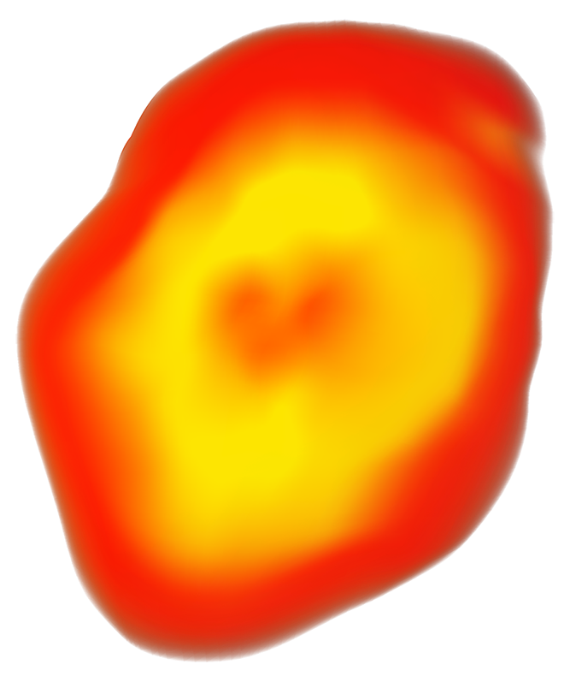
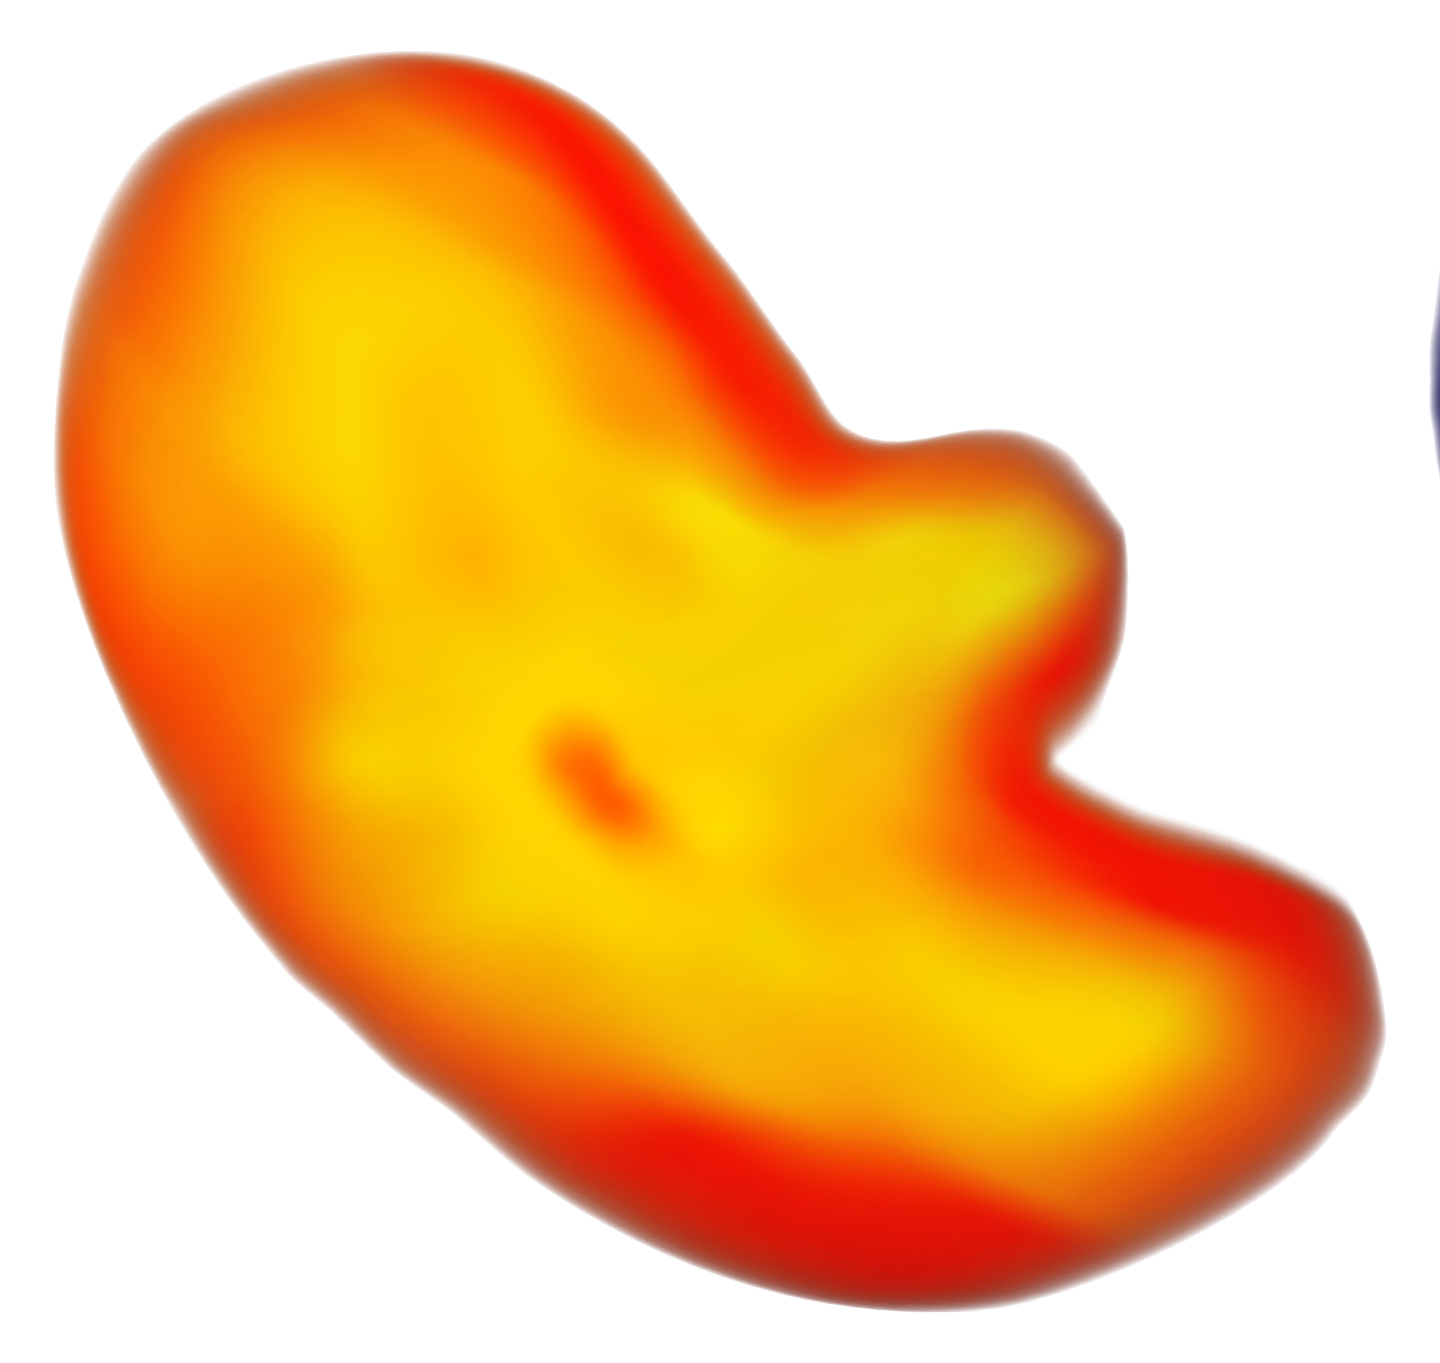
Let’s Look at the Data

Slide 10
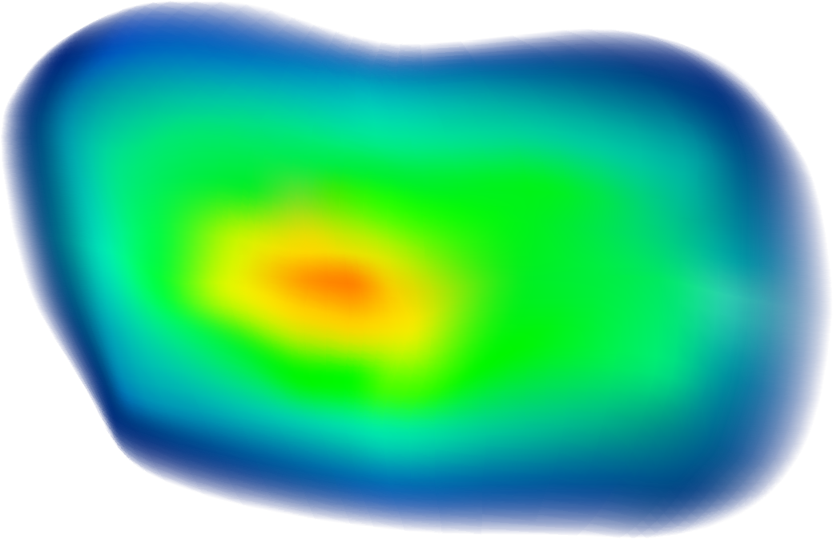
THANKS!
Do you have any questions?
youremail@freepik.com
+34 654 321 432
yourwebsite.com
Please keep this slide for attribution

